Slide 1
Anomaly Detection in Healthcare Provider Data
Final Presentation: Infosys Springboard Internship 2024
Submitted by:
Rudrani Ghosh

Slide 2
Problem Statement
The goal is to detect anomalies in a healthcare provider dataset to identify potential fraudulent claims.

Slide 3
Dataset Details
The dataset contains 100,000 entries of healthcare provider’s insurance claims data, including categorical and numerical features. There were initially 100,000 rows and 27 columns.
Some Categorical Columns: National Provider Identifier, Last Name, First Name, Middle Initial, Credentials, Gender, Entity Type, Street Address 1, Street Address 2, City, State Code, Postal Code of the Provider, HCPCS Code, HCPCS Description, HCPCS Drug Indicator
Numerical Columns: Number of Services, Number of Medicare Beneficiaries, Number of Distinct Medicare Beneficiary/Per Day Services, Average Medicare Allowed Amount, Average Submitted Charge Amount, Average Medicare Payment Amount, Average Medicare Standardized Amount
The final dataset after standardization consisted of 100000 rows and 11 columns

Slide 4
Preprocessing Steps
Converting Object to Numeric Type
Looking for Missing Values and imputing them with Mean
Checking for Duplicate Values
Merging the name columns into a single column- Full Name
Merging the address columns
Making the credentials column follow a standard nomenclature [ MD is same as M.D. and so on]
Frequency encoding categorical columns.
Standardizing numerical columns.
Dimensionality Reduction using PCA

Slide 5
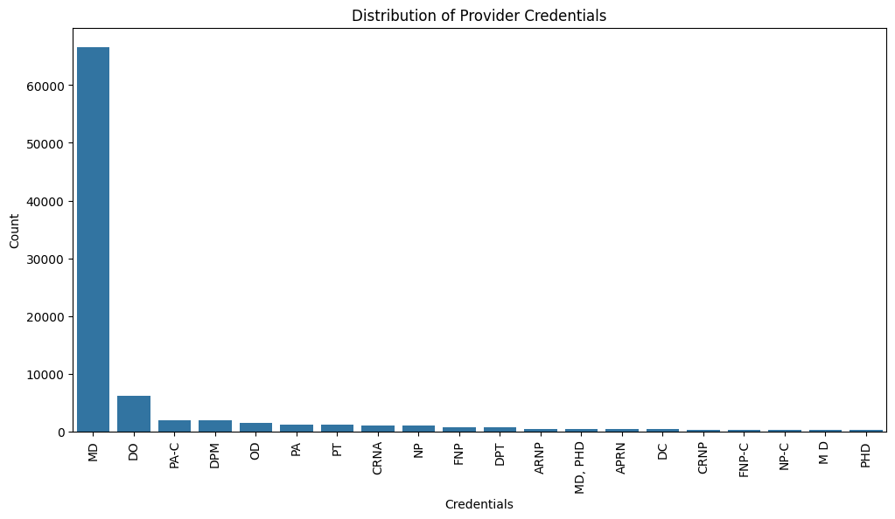
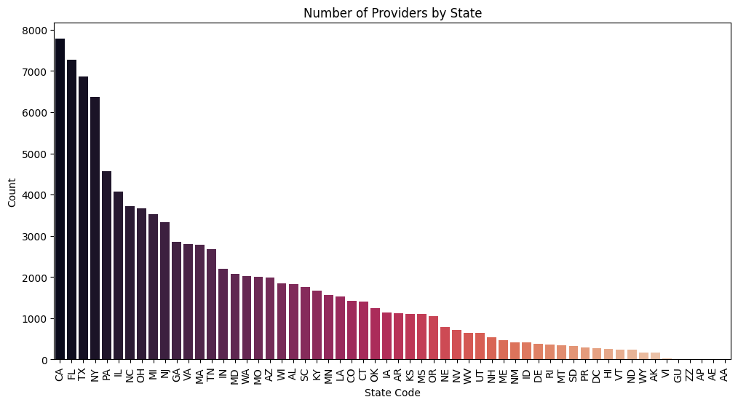
Exploratory Data Analysis Results:

Slide 6
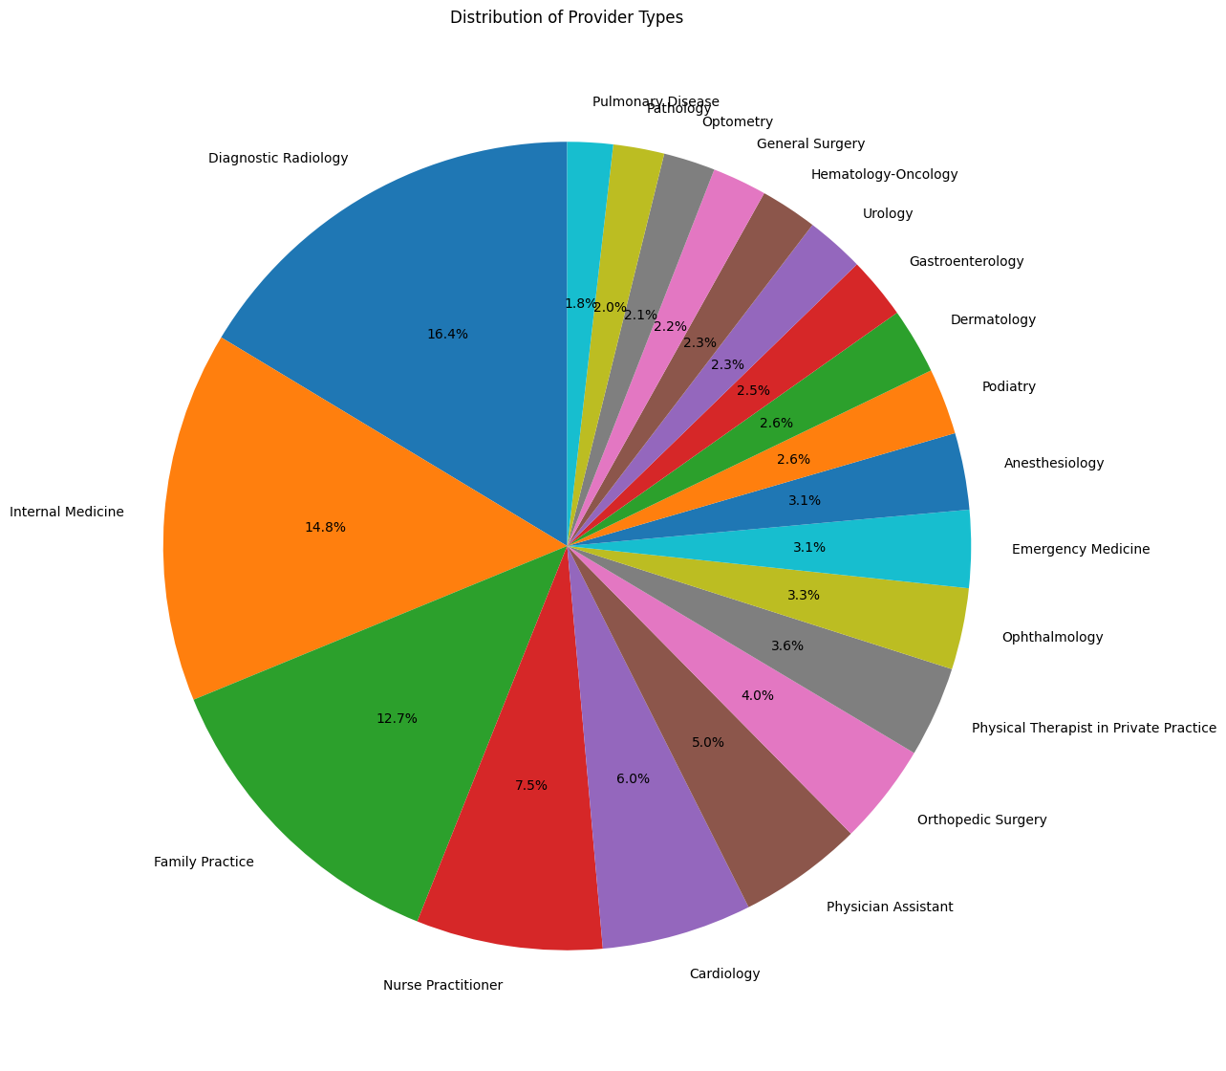
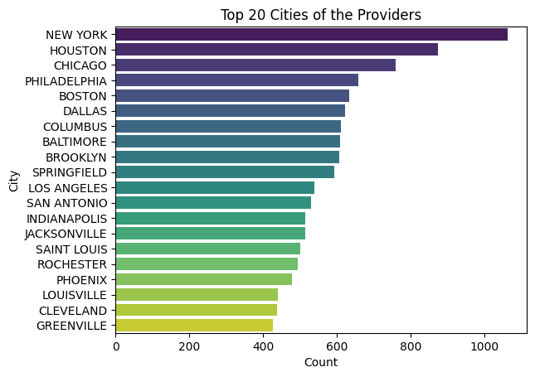

Slide 7
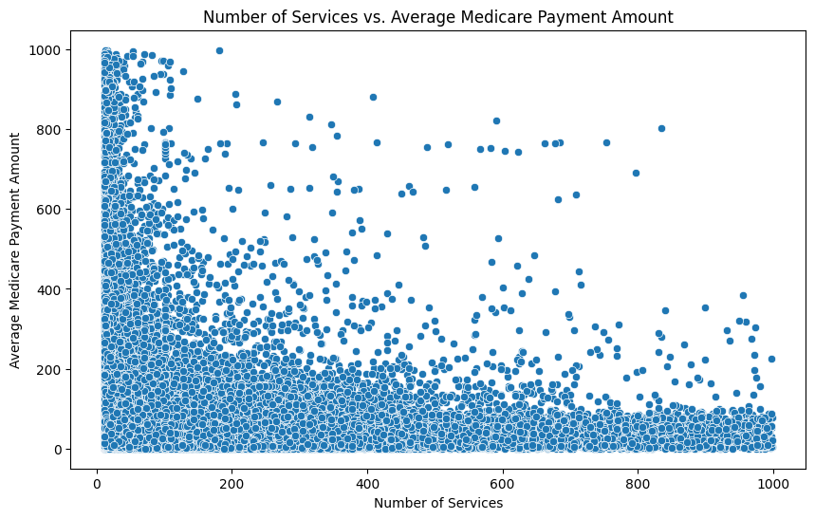
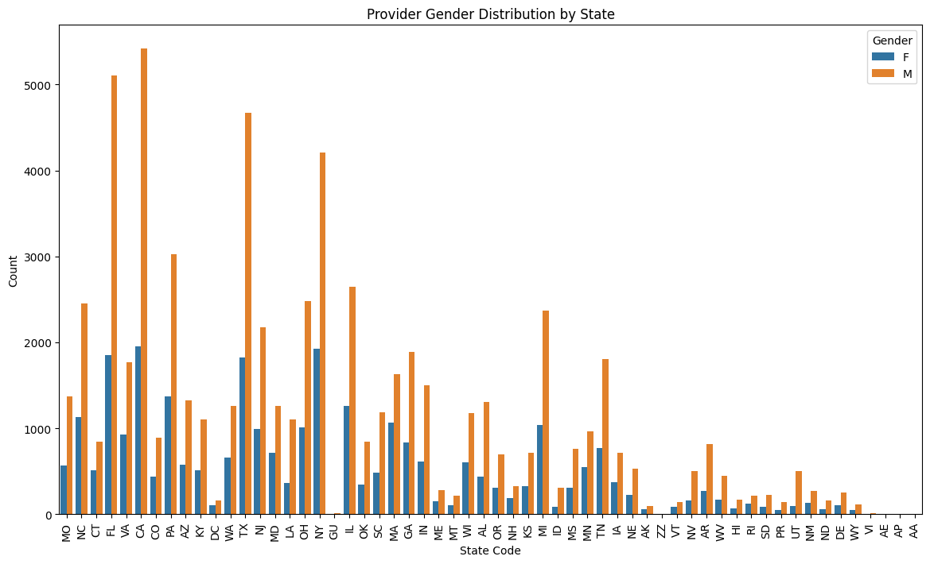
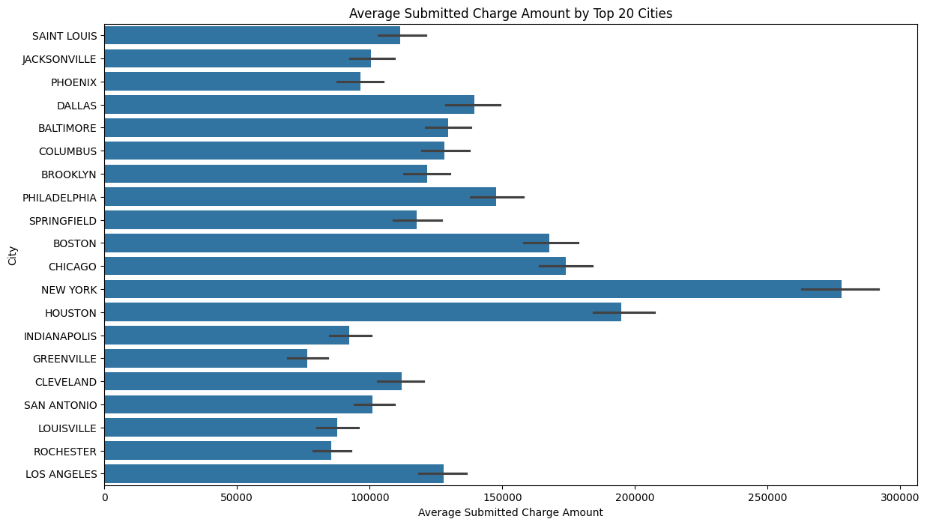
Bivariate Analysis

Slide 8
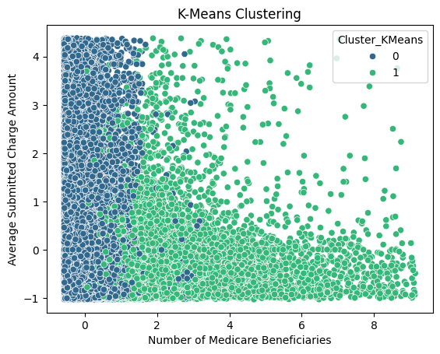
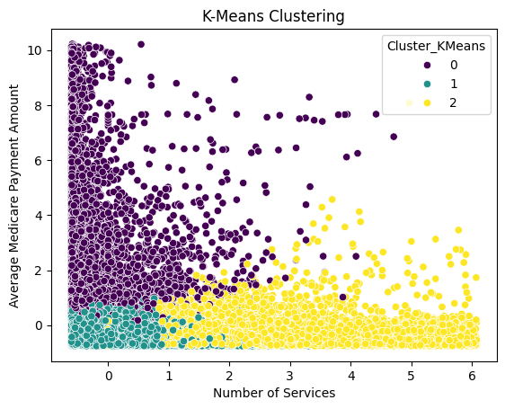
Clustering Results (K-Means)

Slide 9
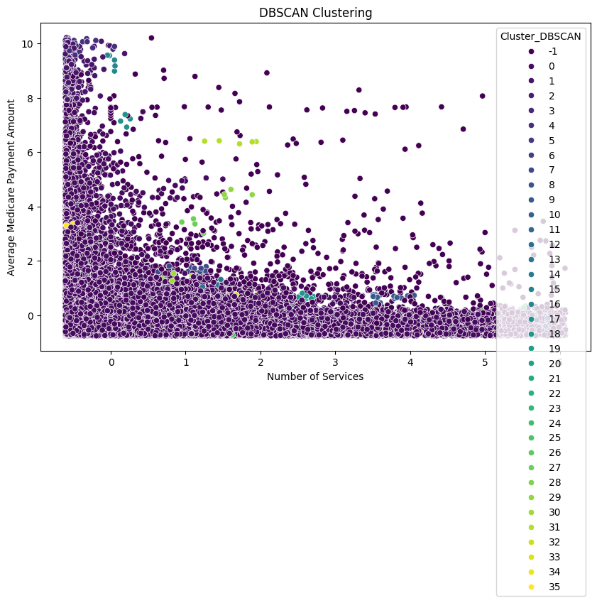
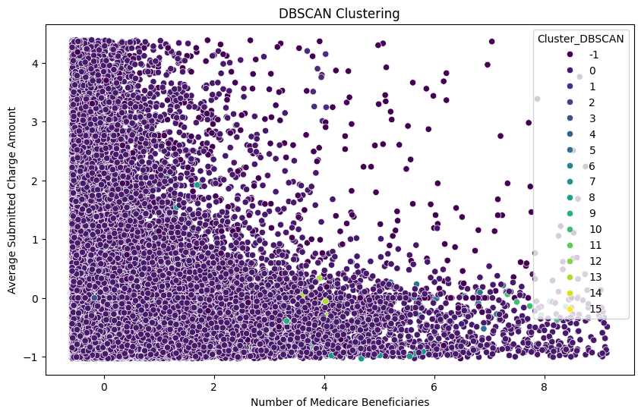
Clustering Results (DBScan)
After setting the epsilon radius as 0.7 and minimum number of samples as 6, we found 788 noise points, and 17 clusters (-1 to 15)
After setting the epsilon radius as 0.5 and minimum number of samples as 4, we found 1395 noise points, and 37 clusters (-1 to 35)

Slide 10
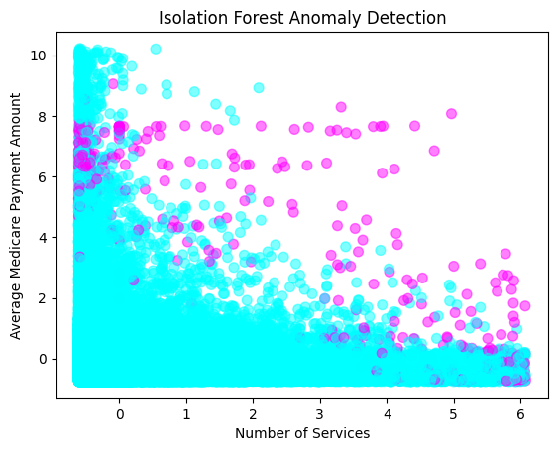
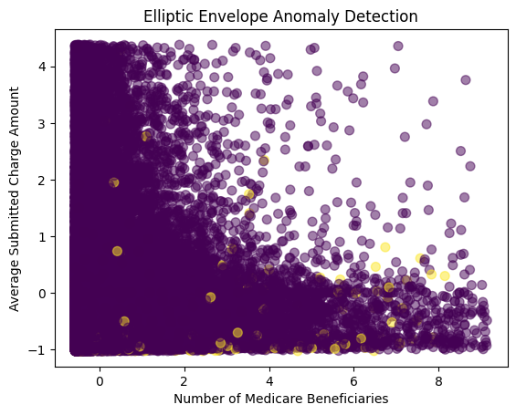
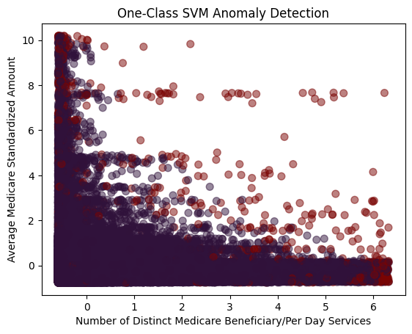
ML Algorithm Results
Using contamination as 0.005 and random_state as 0, the Isolation Forest model detected 500 anomalies
Using contamination as 0.007 and random_state as 42, the Elliptic Envelope model detected 700 anomalies
Using One-Class SVM model and setting gamma as 'auto' and nu as 0.01, 1012 anomalies have been detected

Slide 11
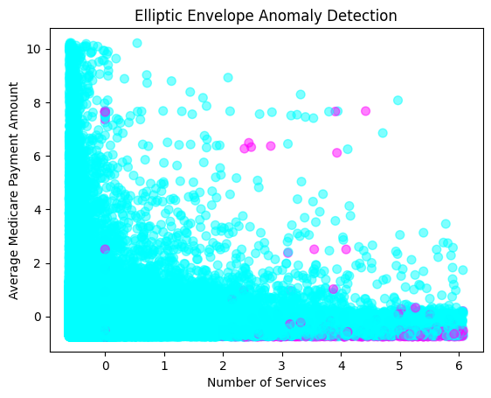
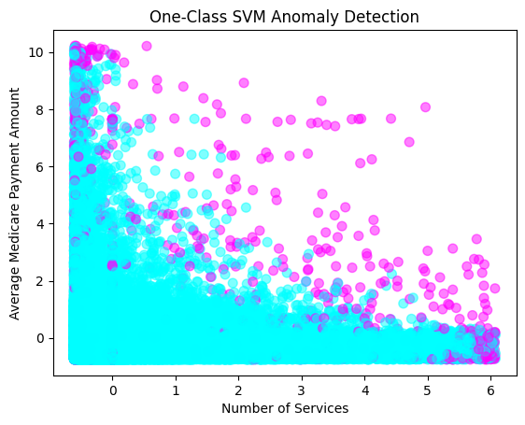
ML Algorithm Results using same columns
Using contamination as 0.005 and random_state as 0, the Isolation Forest model detected 500 anomalies
Using contamination as 0.007 and random_state as 42, the Elliptic Envelope model detected 700 anomalies
Using One-Class SVM model and setting gamma as 'auto' and nu as 0.01, 1012 anomalies have been detected

Slide 12
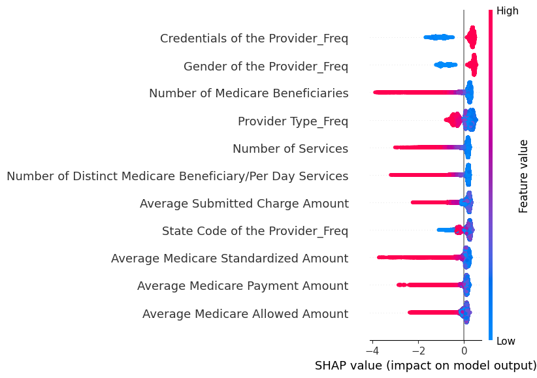
SHAP ANALYSIS OF Isolation Forest Model
INTERPRETATION
- The following columns tend to negatively affect the output:'Number of Services',
'Number of Medicare Beneficiaries',
'Number of Distinct Medicare Beneficiary/Per Day Services',
'Average Medicare Allowed Amount',
'Average Medicare Payment Amount',
'Average Medicare Standardized Amount',
- this shows the tendency of fraud increases with higher values in such columns

Slide 13
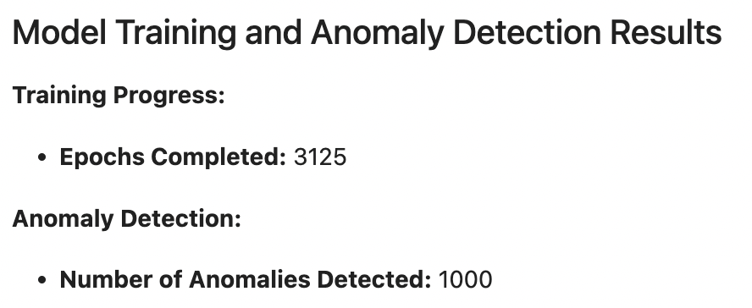
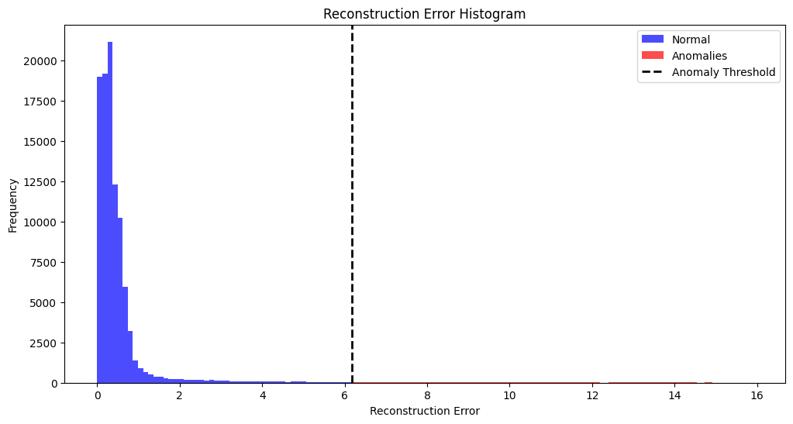
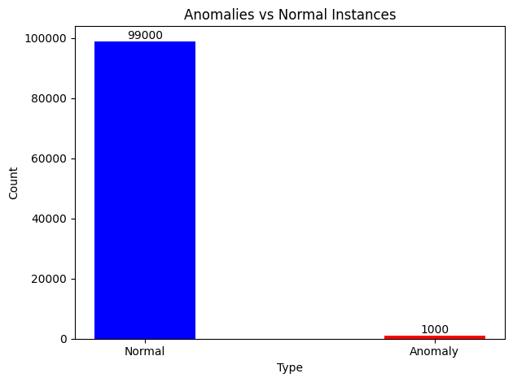
Deep Learning Results

Slide 14
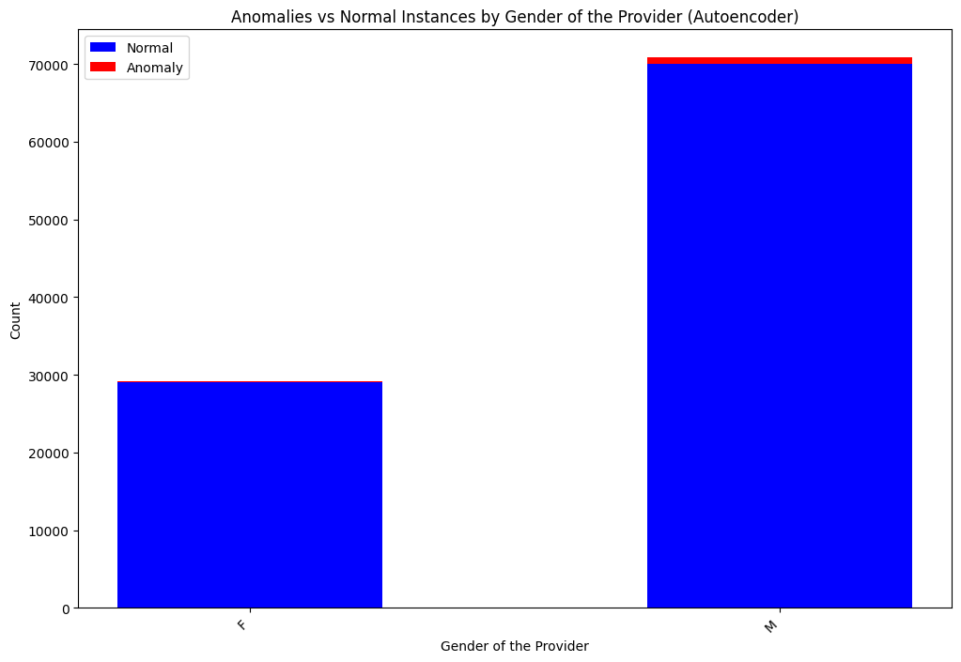
Deep Learning Results

Slide 15
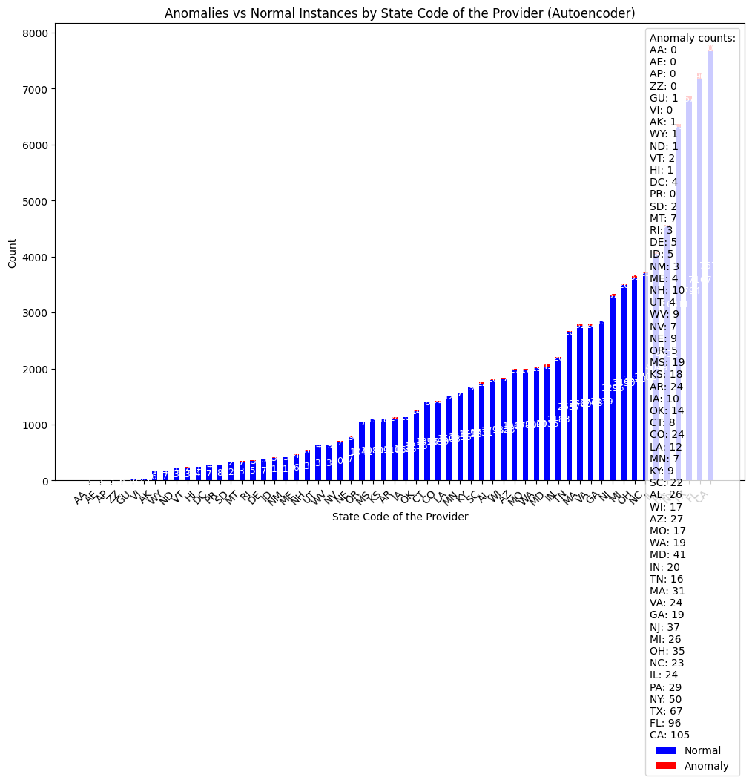

Slide 16
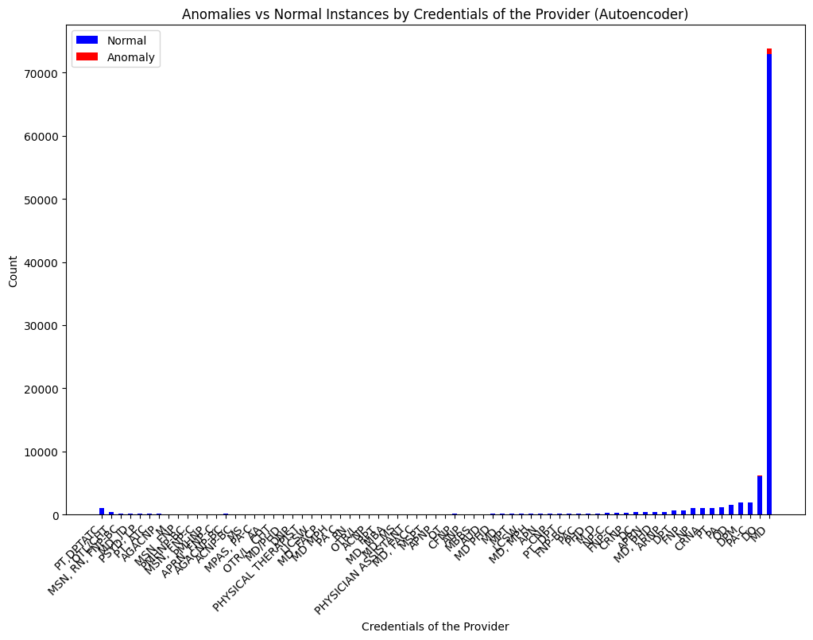

Slide 17
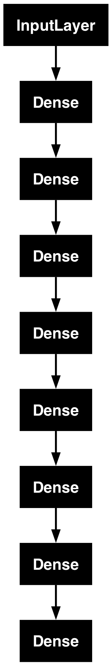
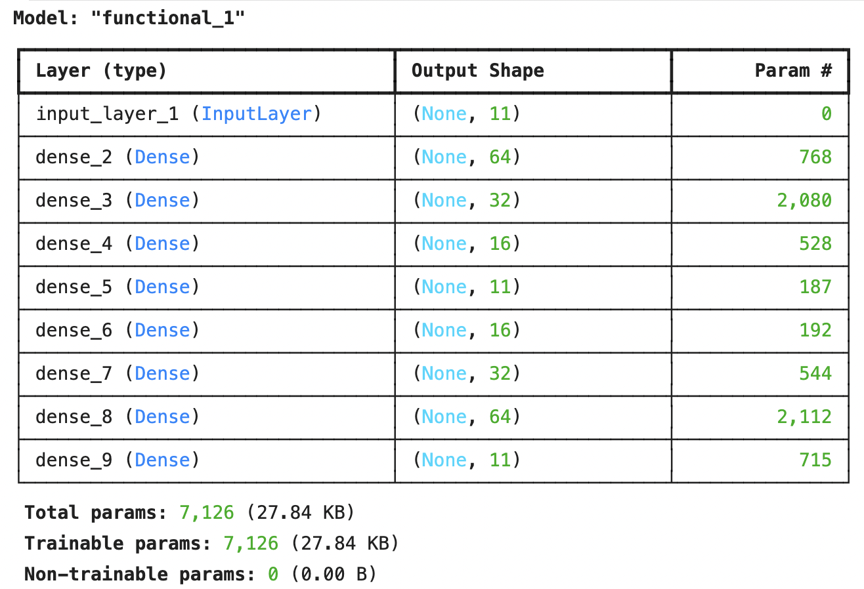
Model Architecture
Interpretation:
The autoencoder consists of an encoding part (first four dense layers) and a decoding part (last four dense layers). The encoding layers reduce the input data to a lower-dimensional representation, while the decoding layers reconstruct the data back to its original dimensions. This structure helps the model learn an efficient representation of the input data, which can be useful for anomaly detection.

Slide 18

Comparison of Normal and Outlier Data MSE Values
Anomaly Data MSE:
Value: 9.585
Interpretation: The MSE for anomaly data is 9.585. This significantly higher value compared to the normal data MSE suggests that the autoencoder struggles to reconstruct the anomalous data points accurately. The high reconstruction error confirms the presence of anomalies, highlighting that these data points differ substantially from the normal data.
Normal Data MSE:
Value: 0.464
Interpretation: The MSE for normal data is 0.464. This indicates a low average reconstruction error for the data points that are not considered anomalies. The autoencoder performs well on the normal data, accurately reconstructing the input data with minimal error.

Slide 19
Thank You

